Slide 1
IBM University Engagement Project Submission
“Exploring the Power of Machine Learning with IBM Cloud”
An AI-Powered Nutrition Agent built with IBM watsonx.ai, Granite
Foundation Models, IBM Bob and watsonx Orchestrate
Soumit Mal • B.Tech CSE (Data Science) • AI & Cloud Technologies Intern
Live Demo: ibm-edunet-soumit.vercel.app
GitHub: github.com/Soumit2k05/IBM-EDUNET-SOUMIT

Slide 2

Project Title – NutriBot — AI-Powered Nutrition Agent
Domain of Project – Healthcare & Wellness (AI for Personalized Nutrition)
Student Name | Recent Passport Photo | Email ID | Mobile number [WhatsApp]
SOUMIT MAL |  | soumitmal10@gmail.com | 9002570505

Slide 3
Problem Statement –
Accessible, Personalized Nutrition Guidance
Millions of people struggle to access affordable and personalized nutrition guidance, especially in developing countries like India.
Existing diet applications provide generic meal plans without considering age, gender, BMI, allergies, regional food preferences, or medical conditions.
Professional dieticians provide accurate recommendations but consultations are expensive, time-consuming, and difficult to access regularly.
Families require separate diet plans for different members, yet most nutrition applications only support a single user profile.
Manual calculation of BMI, calorie requirements, macronutrients, and meal planning is complicated and prone to human error.
The objective is to develop an AI-powered Nutrition Agent that delivers safe, culturally relevant, personalized dietary recommendations using IBM Granite models and IBM watsonx.ai.

Slide 4
Proposed Solution –
IBM Watsonx.Ai – Granite Foundation Models & Autoai
Developed NutriBot, an intelligent AI-powered nutrition assistant using Flask, IBM watsonx.ai, and Granite Foundation Models.
Utilizes IBM Granite LLM to understand natural language queries and provide personalized nutrition recommendations.
Generates customized meal plans based on age, weight, BMI, activity level, allergies, dietary preferences, and health goals.
Supports multi-user family profiles, allowing each family member to receive personalized recommendations within a single application.
Integrates an AutoAI-based obesity risk prediction model that provides health-risk analysis alongside conversational nutrition guidance.
Uses IBM watsonx.ai Runtime to deploy the trained ML model as a REST API, enabling real-time predictions and scalable cloud deployment.

Slide 5
TECHNOLOGY USED
IBM CLOUD & AI TECHNOLOGIES
IBM Cloud & Granite: Used IBM Cloud and Granite Foundation Models for secure, personalized AI nutrition guidance.
IBM AutoAI & Runtime: Optimized the Decision Tree model and deployed it as a REST API using watsonx.ai Runtime.
IBM Bob: Flask development, debugging, and code optimization in VS Code.
Development Stack: Python, Flask, HTML, CSS, JavaScript, and Bootstrap.
MACHINE LEARNING
Algorithm: Decision Tree Classifier (IBM AutoAI Best Pipeline)
Classification: Multi-class (7 Obesity Categories)
Accuracy: 94.8% Cross-Validation
Optimization: Automated Feature Engineering & Hyperparameter Tuning
Deployment: IBM watsonx.ai Runtime REST Endpoint

Slide 6
NutriBot – AI-Powered Nutrition Assistant
Technologies: Developed using IBM Cloud, IBM watsonx.ai, Granite Foundation Models, IBM AutoAI, IBM watsonx.ai Runtime, IBM Bob, Python, Flask, HTML, CSS, JavaScript, and Bootstrap.
Personalized Nutrition: Generates customized meal plans based on age, gender, height, weight, dietary preferences, allergies, medical conditions, and fitness goals.
Health Calculations: Calculates BMI, BMR, TDEE, daily calorie requirements, and macronutrient recommendations for every user.
Machine Learning: Uses an IBM AutoAI-trained Decision Tree Classifier for 7-class obesity prediction with 94.8% cross-validation accuracy.
Deployment: The optimized model is deployed as a live REST API using IBM watsonx.ai Runtime for secure, real-time predictions.
Key Features: Supports multi-user family profiles, AI nutrition chat, nutrition analysis, and responsive cloud-based access and dark mode.

Slide 7
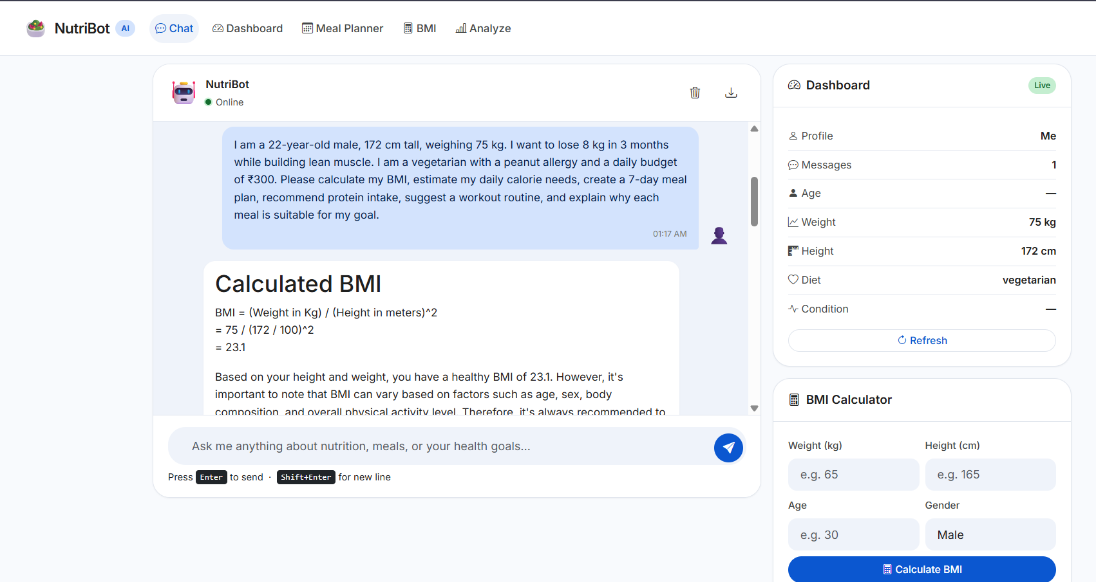
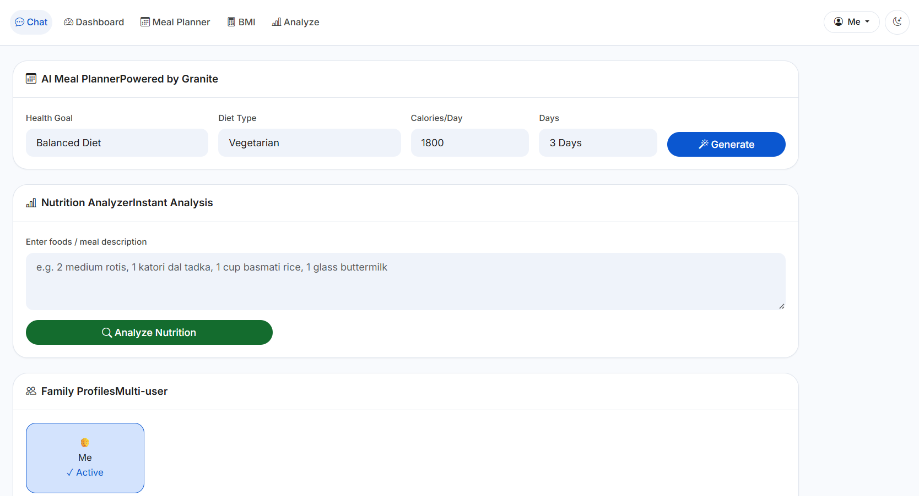
NutriBot Application Showcase
NutriBot provides AI-powered nutrition guidance, BMI/BMR/TDEE calculations, personalized meal planning, nutrition analysis, and multi-user family profiles using IBM Granite Foundation Models and IBM watsonx.ai technologies.

Slide 8
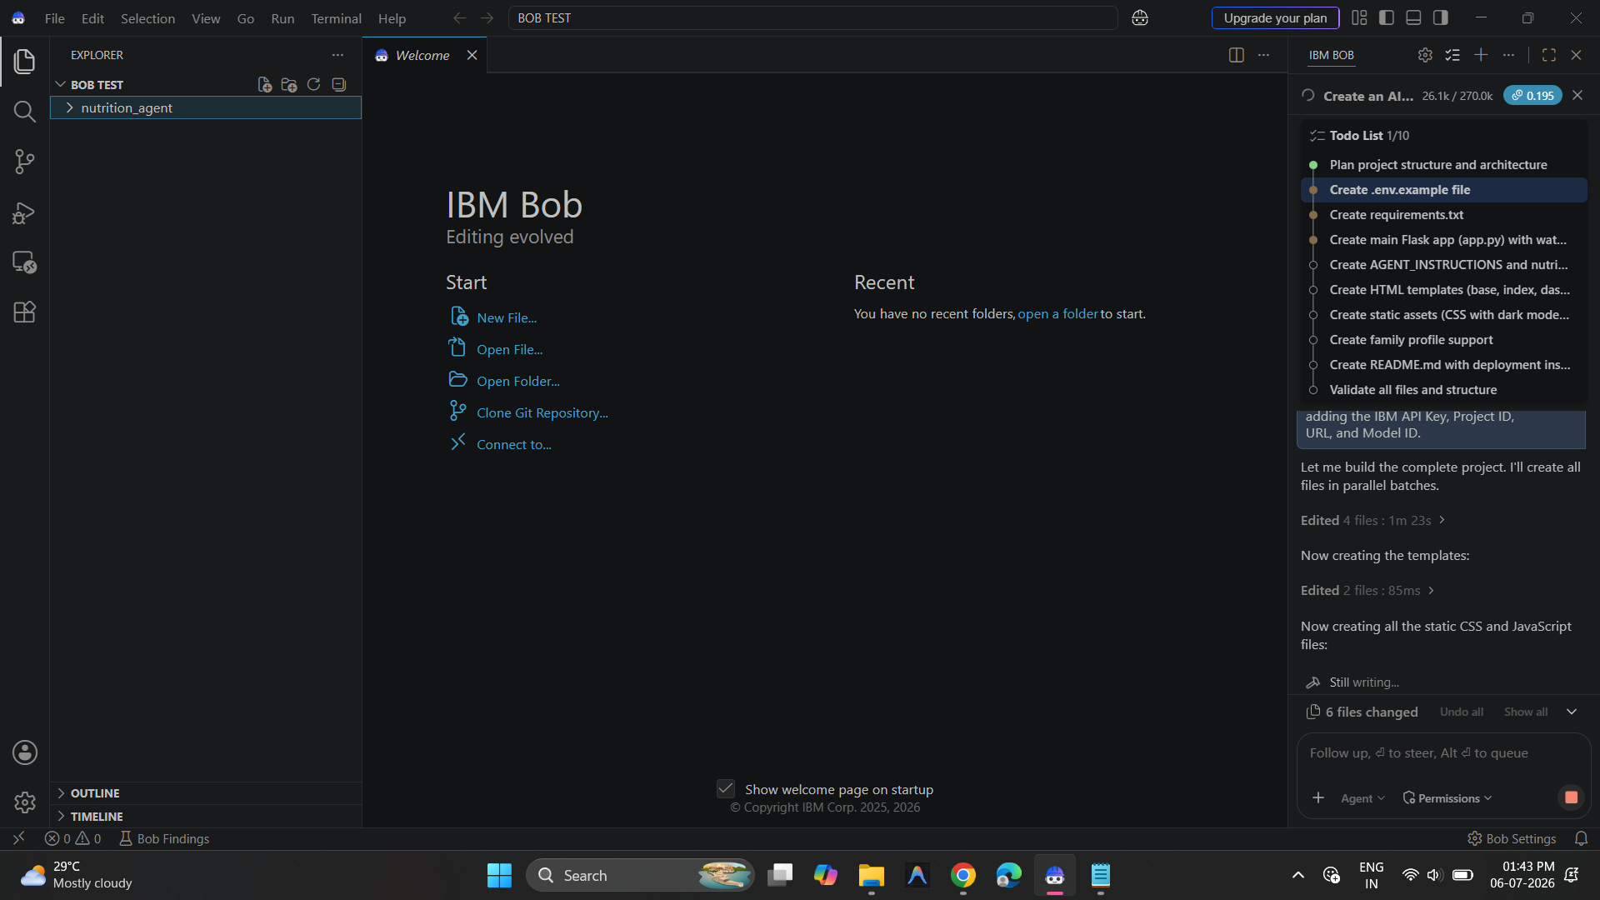
IBM Bob: Accelerating NutriBot Development
AI Pair Programmer: Assisted in developing the NutriBot application.
Code Generation: Generated Python Flask, HTML, CSS, and JavaScript code.
IBM Integration: Helped integrate IBM watsonx.ai and Granite AI services.
Debugging & Optimization: Detected errors and improved code quality.
Development Support: Accelerated implementation and testing of NutriBot features.
IBM BOB INTERFACE

Slide 9
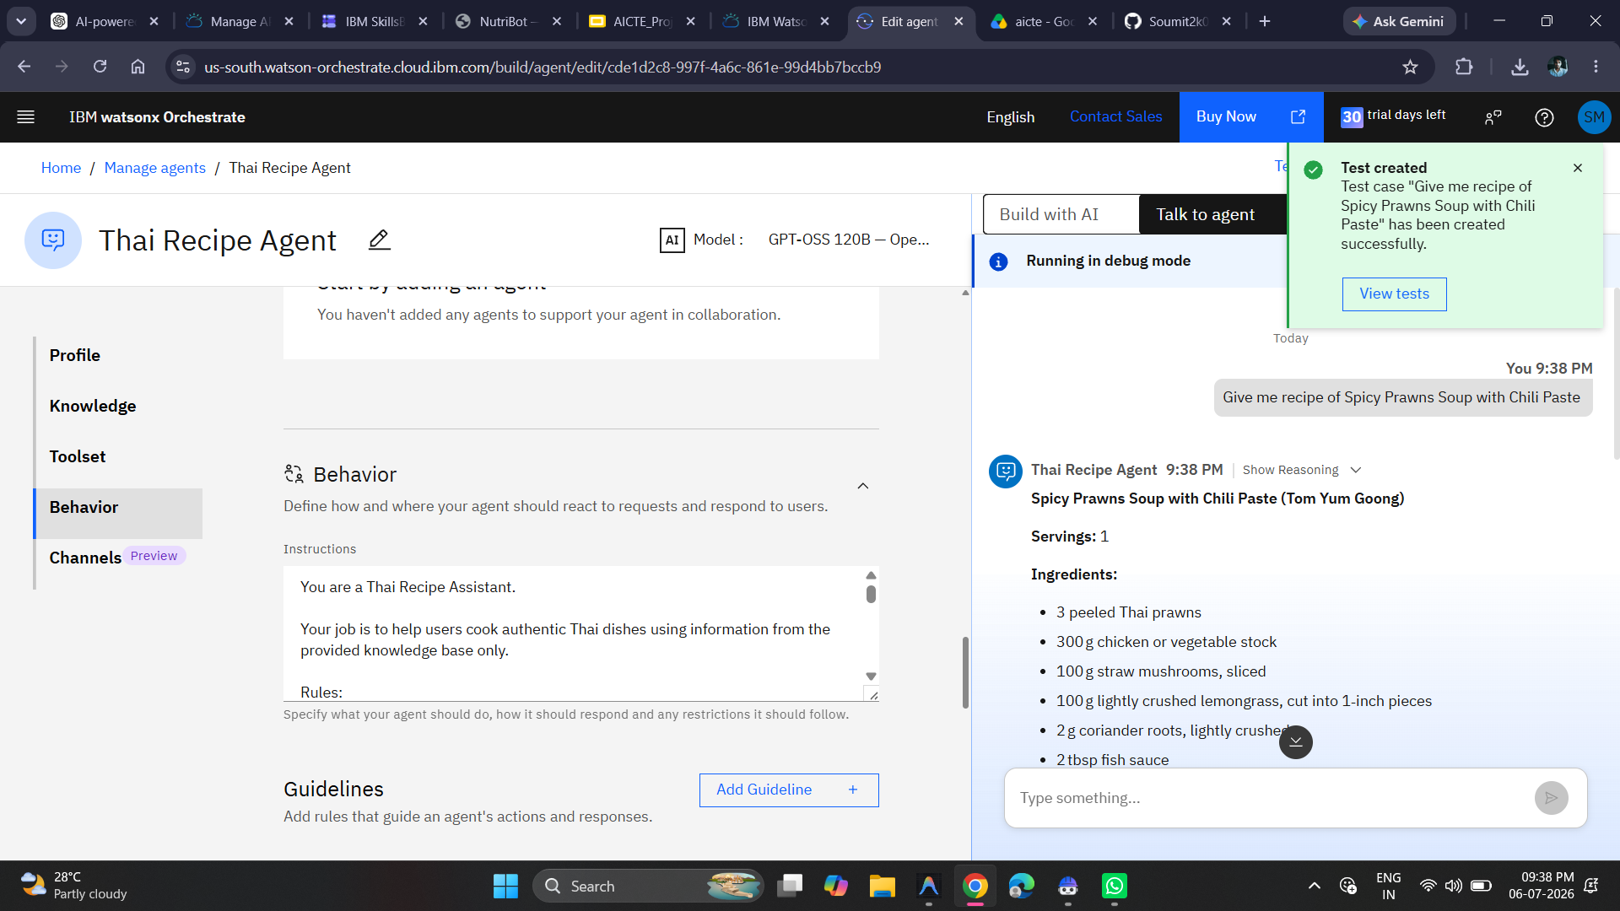
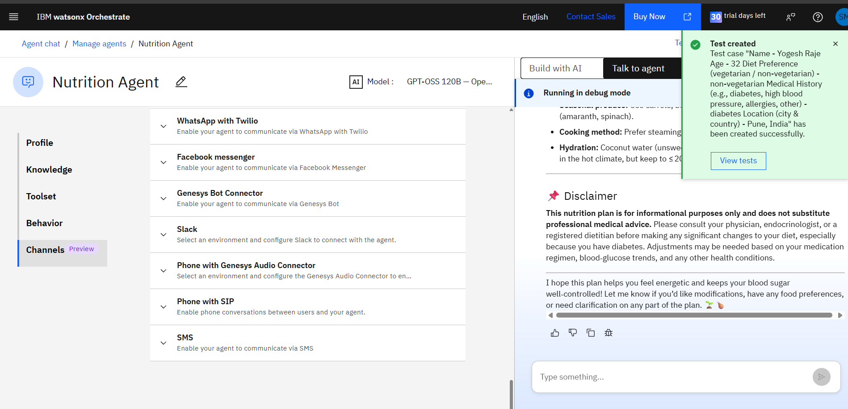
IBM Watsonx Orchestrate: Multi-channel Agents
IBM watsonx Orchestrate: Built and tested Nutrition and Thai Recipe Agents using GPT-OSS 120B for low-code AI deployment.
Nutrition Agent — test case with diabetes-aware meal plan & disclaimer
Thai Recipe Agent — custom behaviour instructions grounded in a knowledge base

Slide 10
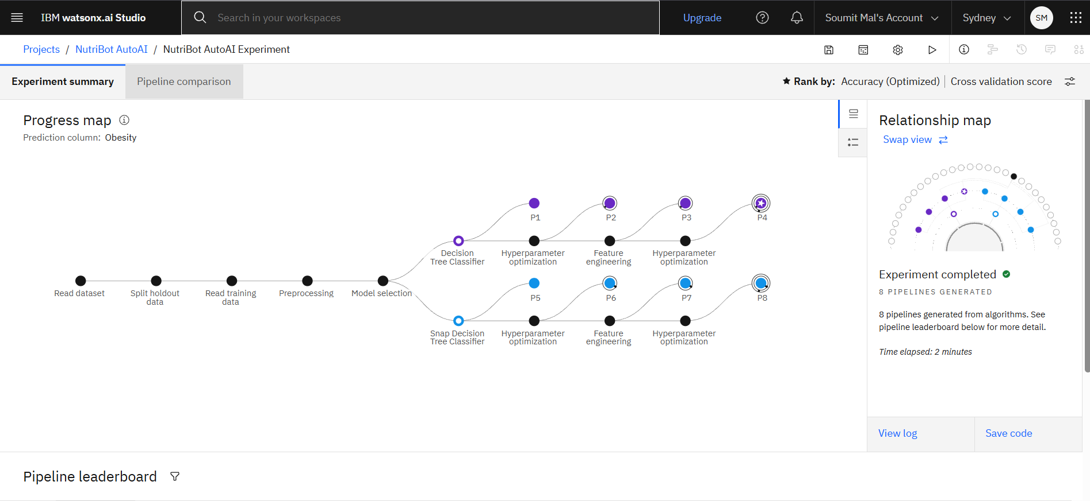
Training Screenshots
PROGRESS MAP

Slide 11
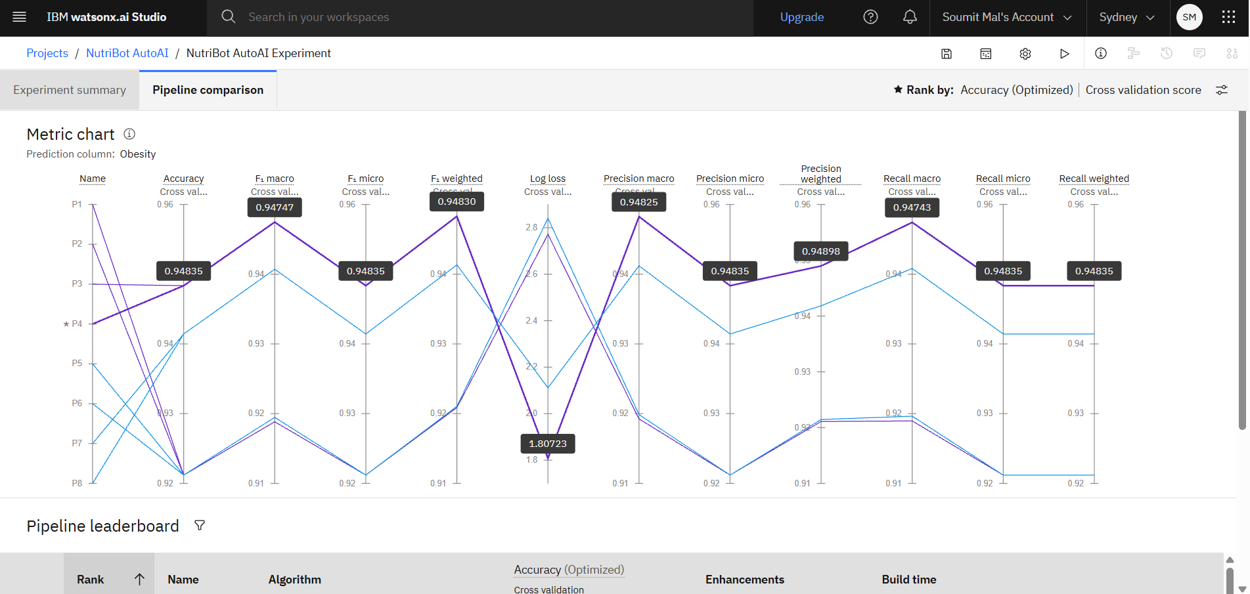
Model Training Screenshots
METRIC CHART

Slide 12
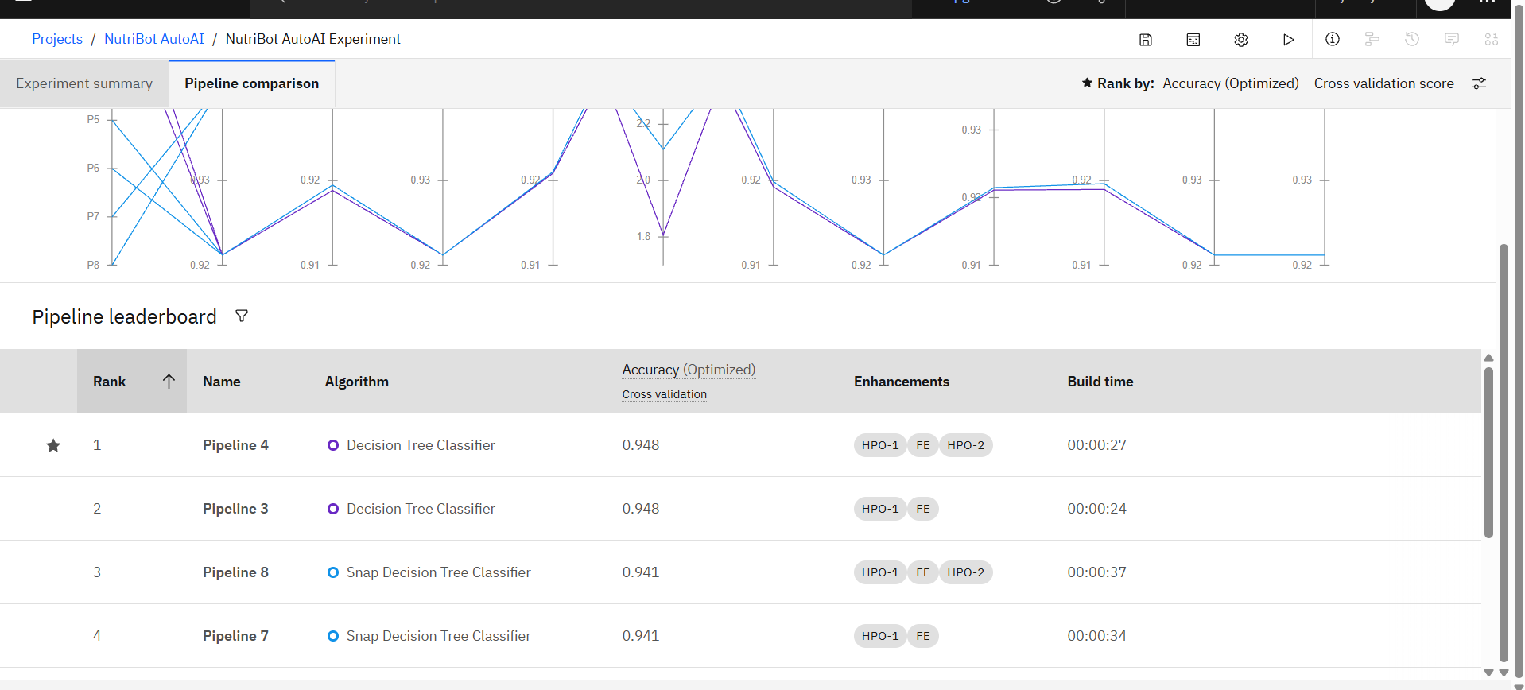
Best Model Screenshot

Slide 13
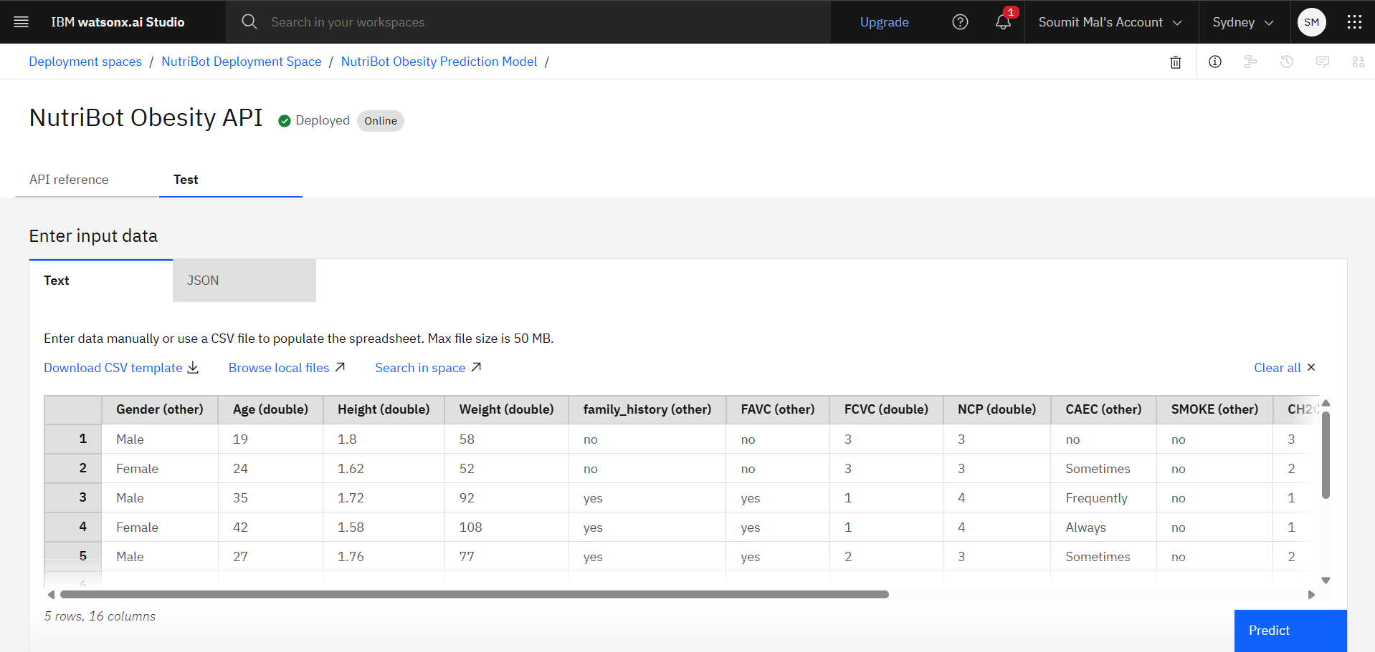
Testing Screenshot

Slide 14
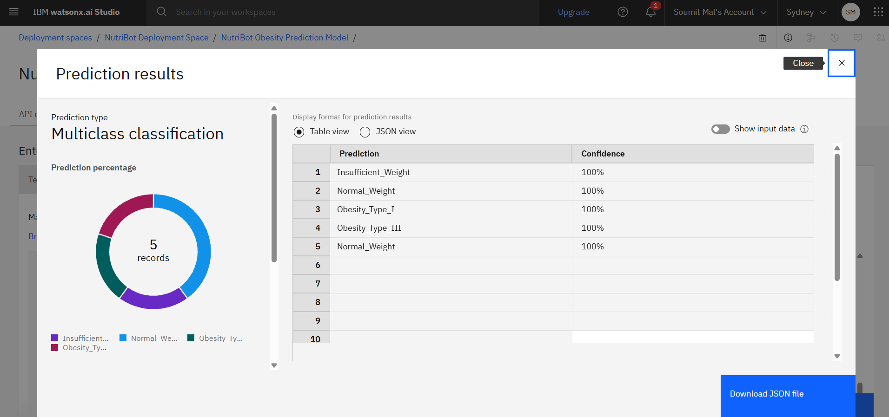
Testing Screenshot

Slide 15
Novelty & Uniqueness
Zero-Form Personalization: Automatically extracts user details such as age, weight, diet, allergies, and fitness goals from natural conversations to generate personalized nutrition guidance.
Multi-User Family Profiles: Supports multiple family members with separate nutrition profiles, meal plans, and conversation history within a single application.
AI + ML Integration: Combines IBM Granite Foundation Models with an IBM AutoAI-trained Decision Tree Classifier achieving 94.8% cross-validation accuracy for obesity risk prediction.
Cloud-Based Deployment: Deploys the optimized model as a live REST API using IBM watsonx.ai Runtime, enabling secure and real-time predictions.
Modern AI Solution: Developed using IBM Cloud, IBM Bob, Python, Flask, HTML, CSS, JavaScript, and Bootstrap to deliver a scalable and responsive web application.

Slide 16
GitHub Repository & Live Deployment
GitHub Repository: https://github.com/Soumit2k05/IBM-EDUNET-SOUMIT
Live Application: https://ibm-edunet-soumit.vercel.app
Repository Includes: Flask application, IBM watsonx.ai integration, IBM Granite AI, AutoAI model, frontend templates, and project documentation.
Key Files: app.py, agent_instructions.py, requirements.txt, .env.example, HTML/CSS/JavaScript templates, and AutoAI model artifacts.
Status: Public GitHub repository with README and successfully deployed, working web application.

Slide 17
Future Scope
Wearable & IoT Integration: Connect smartwatches and fitness bands for real-time monitoring of activity, heart rate, sleep, and calories.
Persistent Cloud Database: Store long-term diet history, health records, and personalized nutrition plans securely for every user.
Voice-Based AI Assistant: Enable hands-free nutrition guidance using IBM watsonx Orchestrate with voice and phone support.
Regional Language Support: Provide personalized nutrition guidance in multiple Indian languages for improved accessibility.
Healthcare & Clinical Integration: Integrate with hospitals, clinics, and health databases to support preventive healthcare and personalized treatment recommendations.
·
·
·

Slide 18
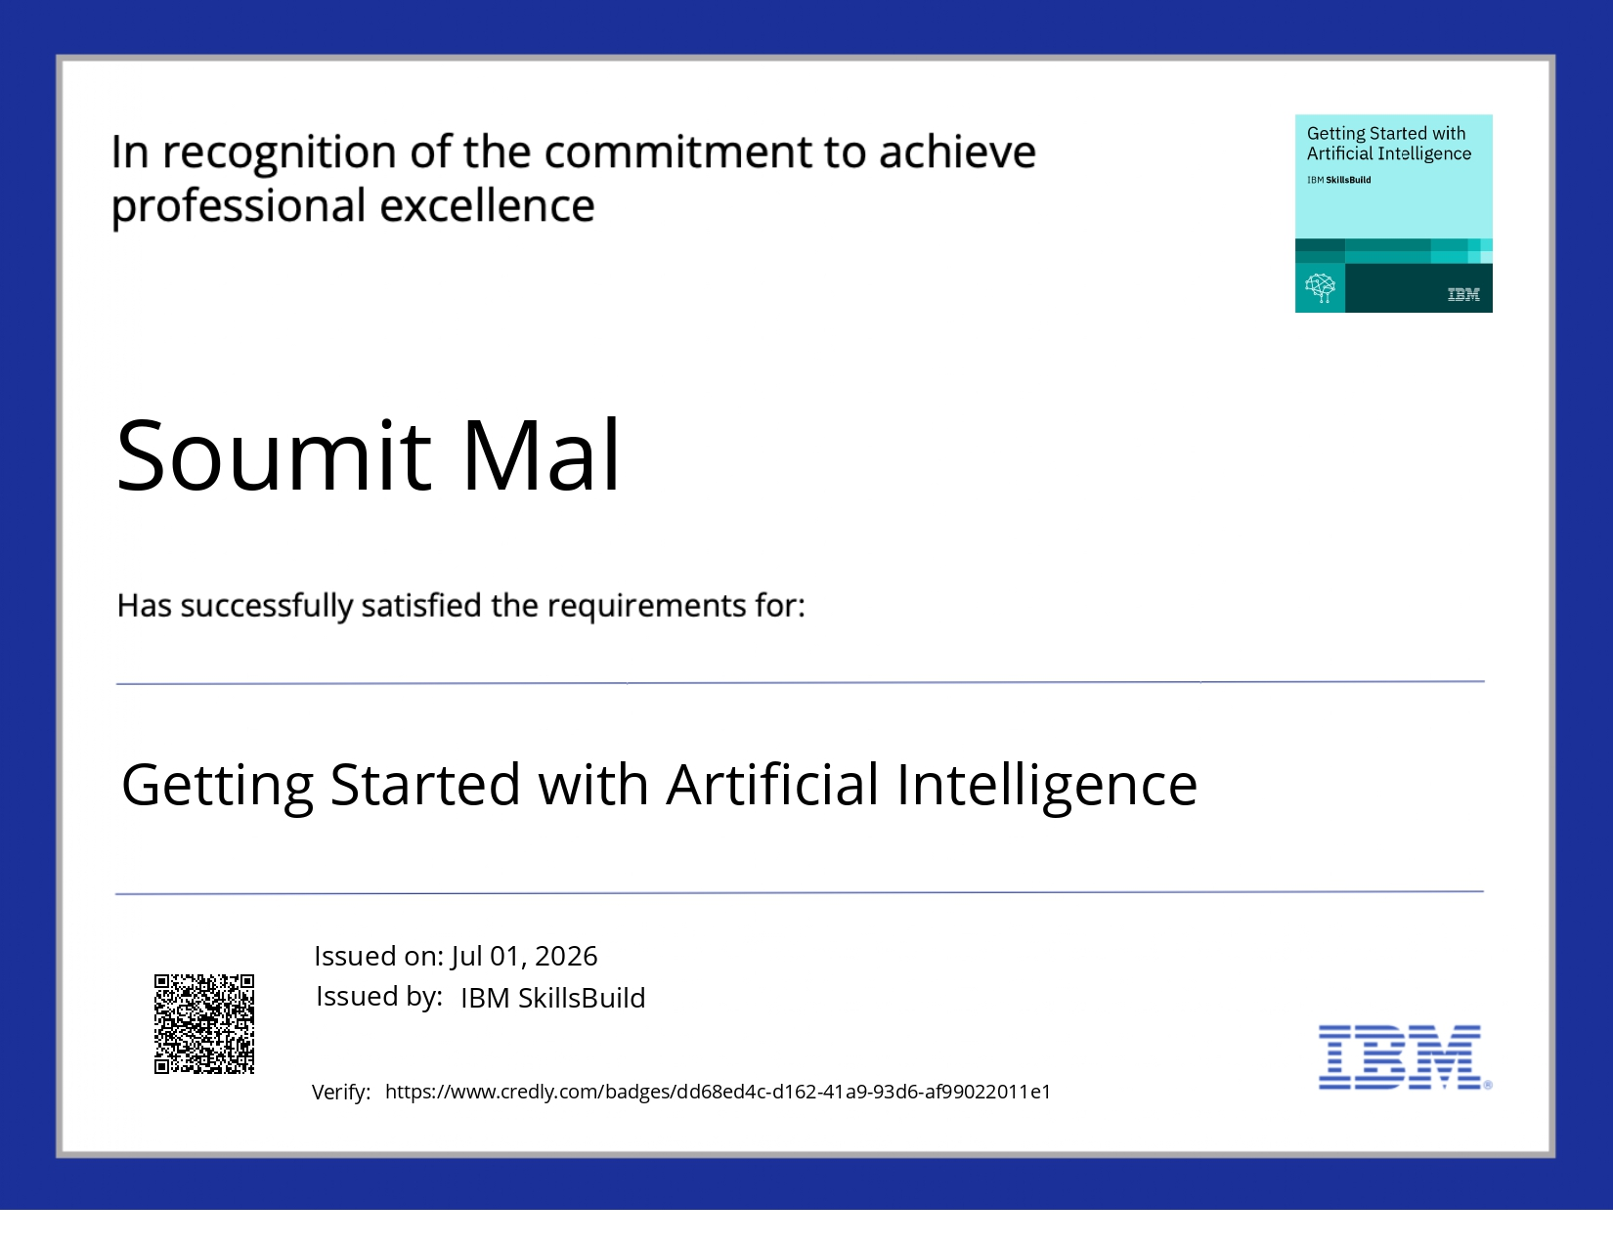
Certificates Earned
Getting Started with Artificial Intelligence — IBM SkillsBuild, Credly-verified, Jul 01, 2026

Slide 19
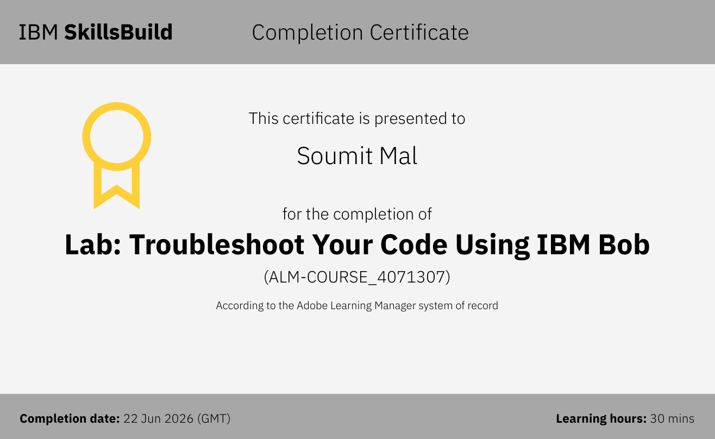
Certificates Earned
Lab: Troubleshoot Your Code Using IBM Bob — IBM SkillsBuild (ALM-COURSE_4071307), Jun 22, 2026

Slide 20


